Slide 1
BAROQUE (1600 – 1750)
Kenny Lim

Slide 2
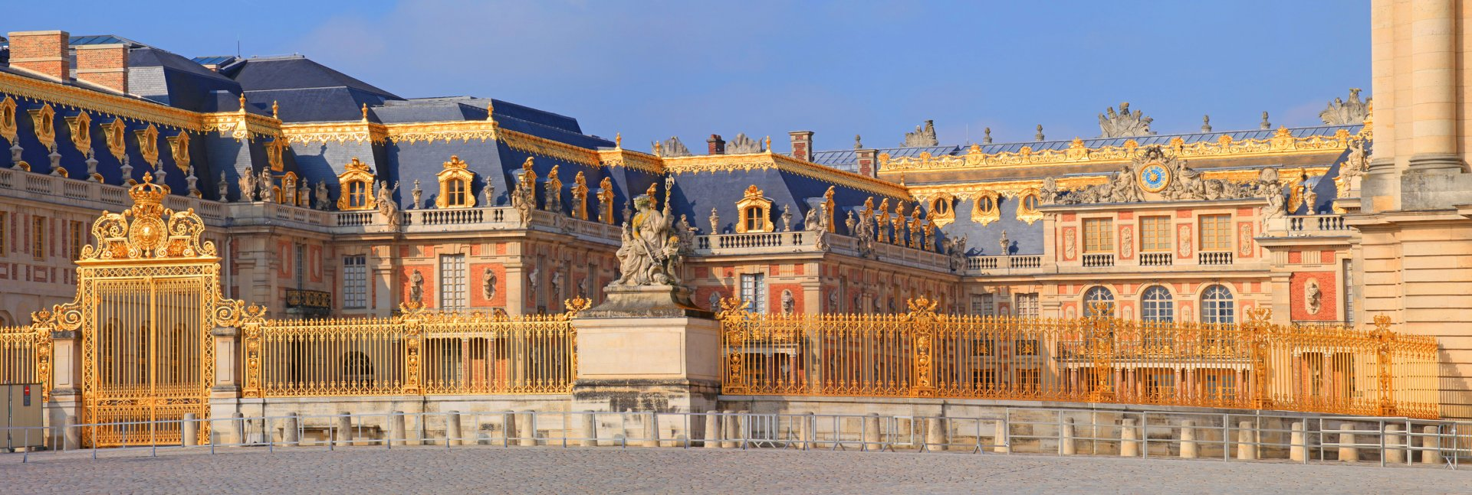
The “Age of absolutism”
Notes:
Rulers exercised absolute power over their subjects.
Derived from the Portuguese word ‘barroco’

Slide 3
Music in Baroque Society
Music was written to order, to meet specific demands mainly from churches and aristocratic courts; opera houses also required constant supply of music.
Courts might employ an orchestra, a chapel choir, and opera singers – size of the musical staff depending on the court’s wealth.
Court musicians are quite wealthy and respected, but they are still servants.
Church musicians in comparison earned way less and had lower status than court musicians.
Most musicians learned their art through family traditions, or by being an apprentice to a musician.
“Conservatoire” or “Conservatory” comes from the Italian for orphan’s home.

Slide 4
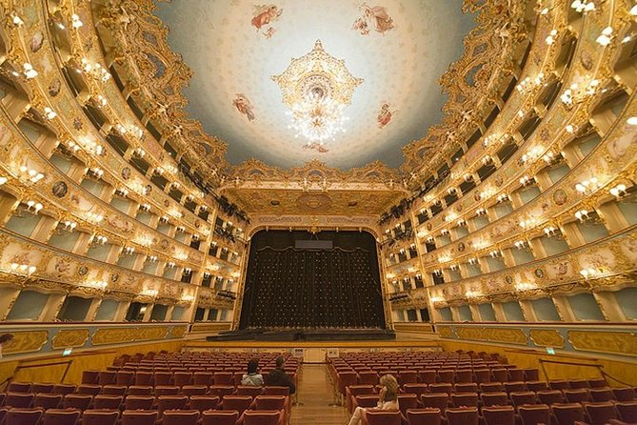
Opera in Baroque period
Some baroque musicians wrote operas for the opera houses, mostly opera houses are in Italy. E.g. Between 1680-1700 there are six opera companies in Venice.

Slide 5
Characteristic of Baroque music
Unity of mood: One basic mood, moods are called affections
Rhythm: Rhythmic patterns heard in the beginning are repeated throughout the piece, providing continuity.
Melody: Melody also designed to provide continuity, even when melody is presented in varied form.
Dynamics: Similar to Rhythm and Melody, continuity of dynamic is used.
Due to instrumentation limits, particularly keyboard instruments, Baroque music’s dynamics have very sudden shift of dynamic levels in a piece.

Slide 6
Texture: Late-Baroque mostly polyphonic, but it might shift to homophonic especially in works that has voice.
Chords and Basso Continuo: Accompaniment of bass part, usually played by at least two instruments – A keyboard instrument and other low instruments (bassoon or double bass)
Words and music: Emphasize words by writing many rapid notes for a single syllable of text.

Slide 7
Baroque Forms
Many baroque compositions include a set of pieces. (Movements)
Movement is a piece that sounds fairly complete and independent but is part of a larger composition.
Ternary ( A – B – A ) & Binary ( A – B ) forms are used

Slide 8
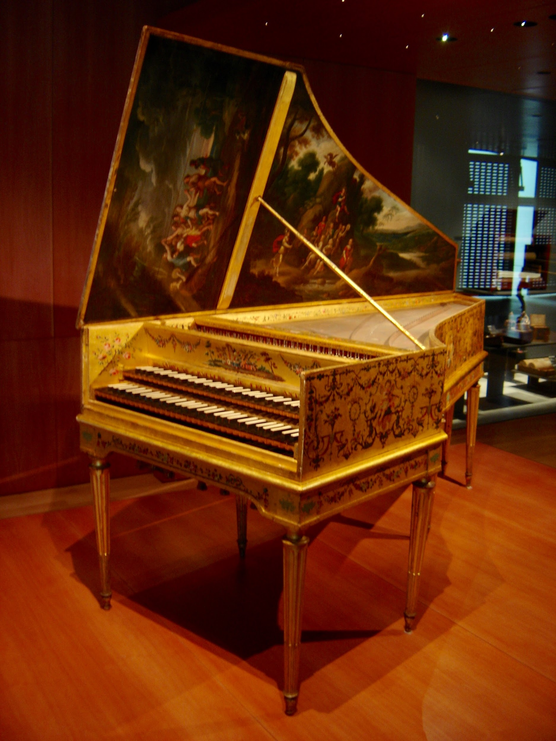
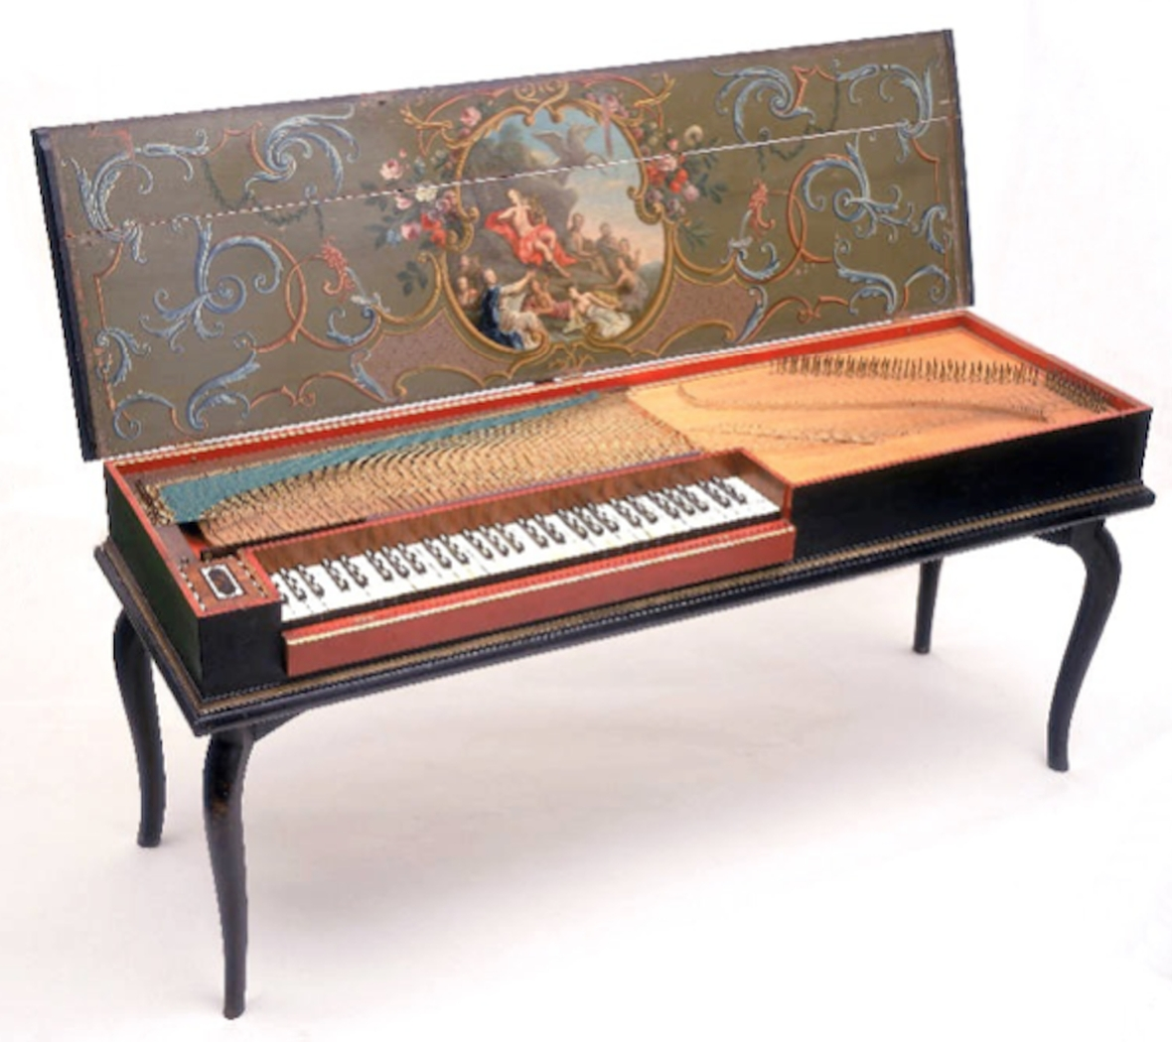
Keyboard instruments
Clavichord
Harpsichord

Slide 9
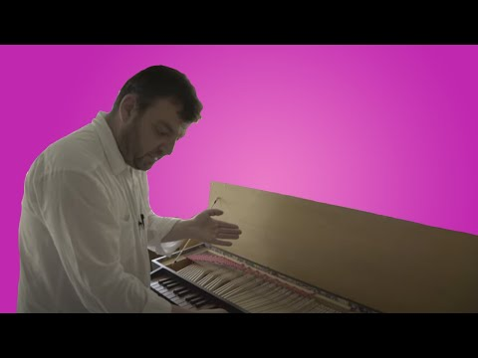

Slide 10
Baroque composers
Claudio Monteverdi (1567 – 1643)
Henry Purcell (1659 – 1695)
Antonio Vivaldi (1678 – 1741)
Johann Sebastian Bach (1685 – 1750)
George Frederik Handel (1685 – 1759)

Slide 11
Types of Baroque music
Concerto Grosso
Fugue
Opera
Baroque Suite
Chorale & Church cantata
Oratorio

Slide 12
Concerto Grosso
A small group of soloist pitted against a larger group of players called the tutti (All)
Usually two to four soloist play with anywhere from eight or more musicians for the tutti.
A concerto grosso normally consists of three movements: FAST, SLOW, FAST)
1st movment (FAST): Ususally vigorous and determined
2nd movement (SLOW): Quieter, often lyrical and intimate
3rd movement (FAST): lively and carefree, sometimes dancelike

Slide 13
Ritornello Form
Based on alternation between tutti and solo sections
Ritornello is used to describe the opening theme in ritornello forms, it is usually played by the tutti, and will return throughout the piece in different keys.
Used in 1st and 3rd movement of Concerto Grosso
a. Tutti (f), ritornello in home key b. Solo
a. Tutti (f), ritornello fragment b. Solo
a. Tutti (f), ritornello fragment b. Solo
Tutti (f), ritornello in home key

Slide 14
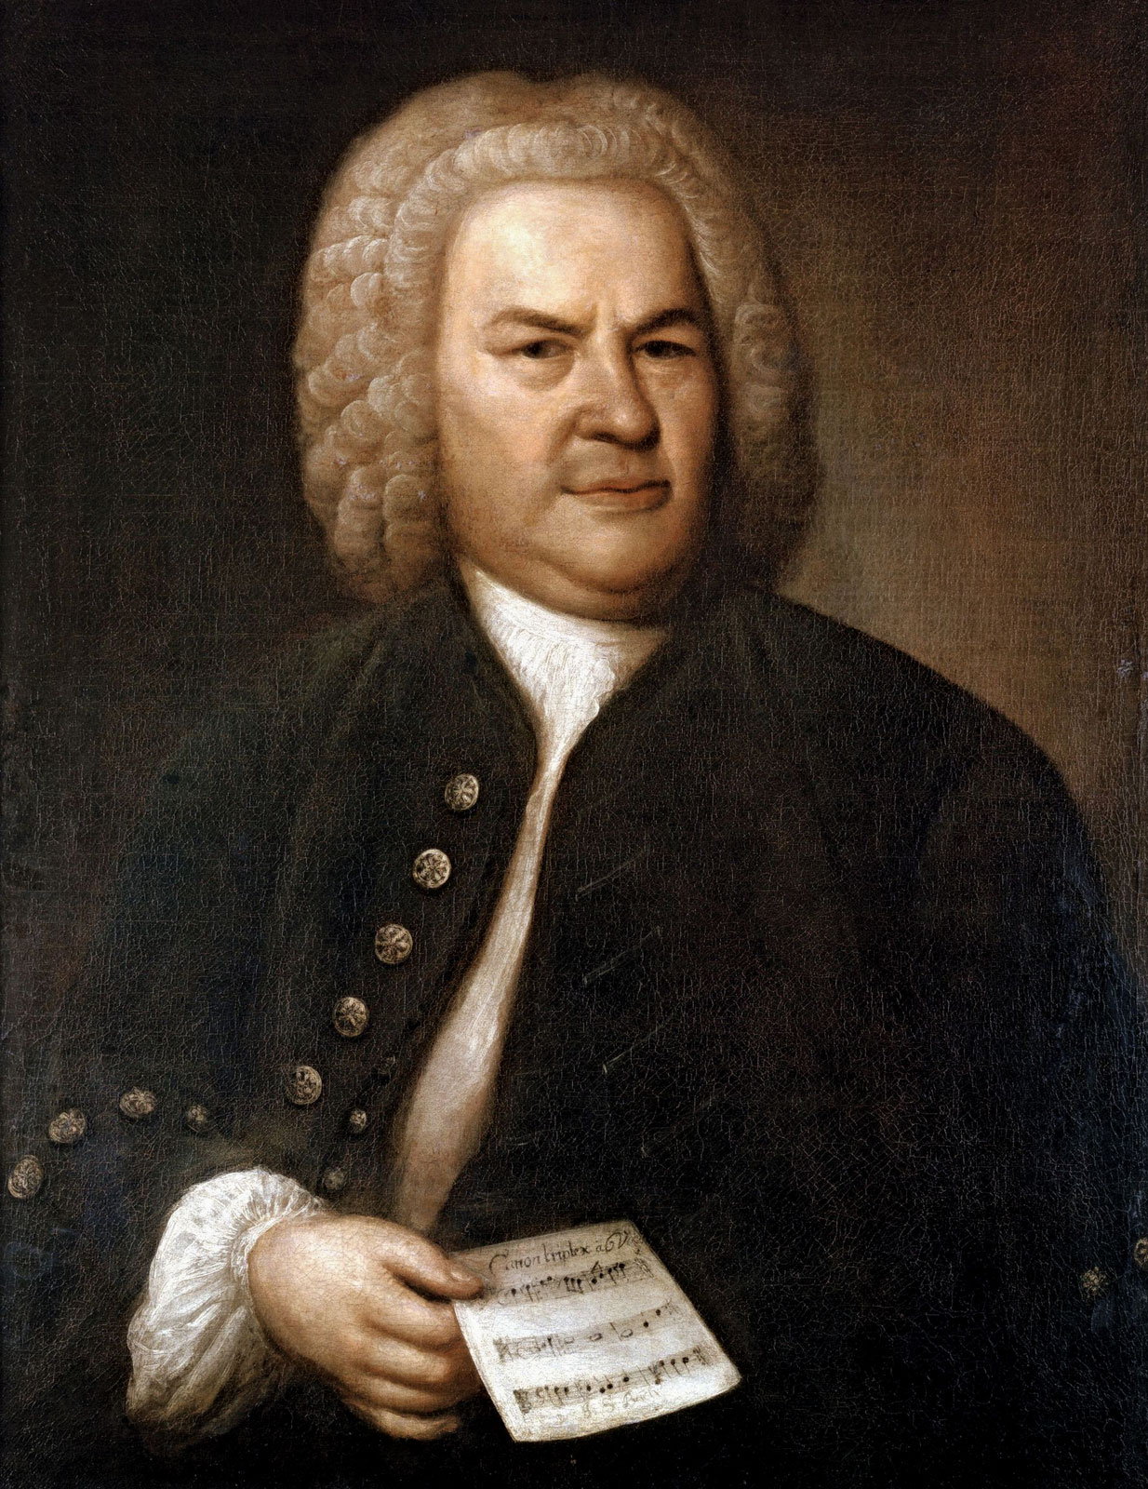
Johann Sebastian Bach (1685 – 1750)
His music was principally written for the Lutheran church
Composed a total of 1128 pieces, 23 further works were lost or unfinished.
His music is unique in its combination of polyphonic texture and rich harmony
Several melodic lines of equal importance often occur at once
Unity of mood
Likes to elaborate a single melodic idea in a piece
Church music also uses operatic forms like the aria and recitative

Slide 15
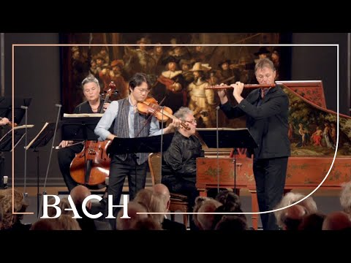
Bach Brandenburg Concerto No.5

Slide 16
Fugue
A polyphonic composition that is based on ONE melodic theme, called the subject
A second melodic idea may be used and called the countersubject
Music texture is layered by several layer of “voices”, normally three, four and five.
Soprano Subject - - - - - - - - - - - - - - - - - - - - - - - - - - - - - - - - - - - - - - - - - - Etc.
Alto Subject - - - - - - - - - - - - - - - - - - - - - - - - - - - - - -Etc.
Tenor Subject - - - - - - - - - - - - - - - - - - - - Etc.
Bass Subject - - - - - - - Etc.

Slide 17
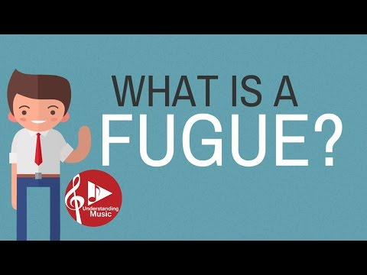

Slide 18
Opera
The unique fusion of music, acting, poetry, dance, scenery, and costumes.
Offering overwhelming excitement and emotion.

Slide 19
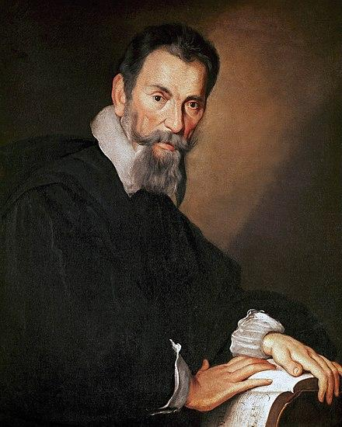
Claudio Monteverdi (1567 – 1643)
Born in Cremona, Italy.
Served at the court of Mantua for 21 years, then appointed music director at St. Mark’s in Venice.
He wanted to create music of emotional intensity
Used dissonances with unprecedented freedom and daring
Introduced new orchestral effects, including pizzicato and tremolo
First composer of operatic masterpieces
Only 3 of his 12 operas were preserved

Slide 20
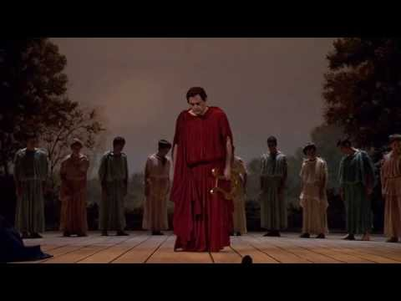
L’Orfeo: Tu Se Morta (You are dead)

Slide 21
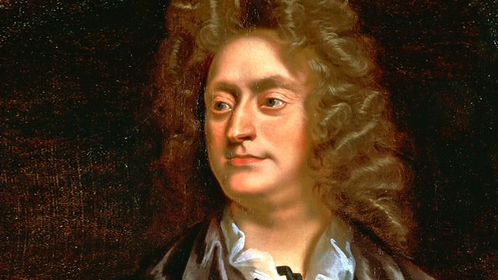
Henry Purcell (1659 – 1695)
Born in London
Mastered all the musical forms of late 17th century England
Only true Opera is Dido and Aeneas (1689)
His vocal music is faithful to English inflection and brings out the meaning of the text
His music is filled with lively rhythms and has a fresh melodic style that captures the spirit of English folksongs
Spiced with dissonances that seemed harsh to the generation of musicians that followed him
Ground bass: Basso Ostinato

Slide 22
Ground bass
Bass is repeated over and over while the melodies above it change
Repeated musical idea is called ground bass, or basso ostinato (obstinate or persistent bass)
The constant repetition of bass pattern gives unity, while the free flow of melodic lines above it results in variety.

Slide 23
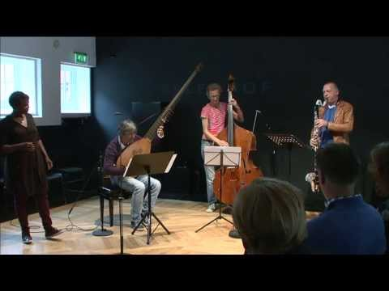

Slide 24
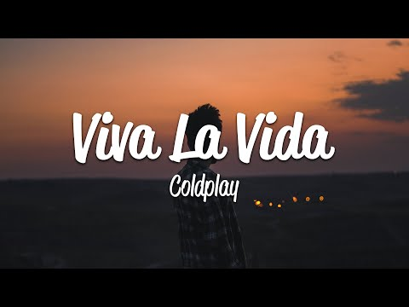

Slide 25
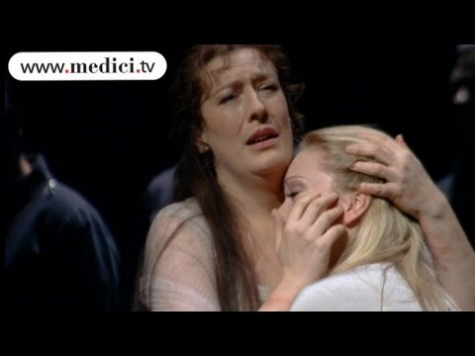
Dido and Aeneas: Dido’s Lament

Slide 26
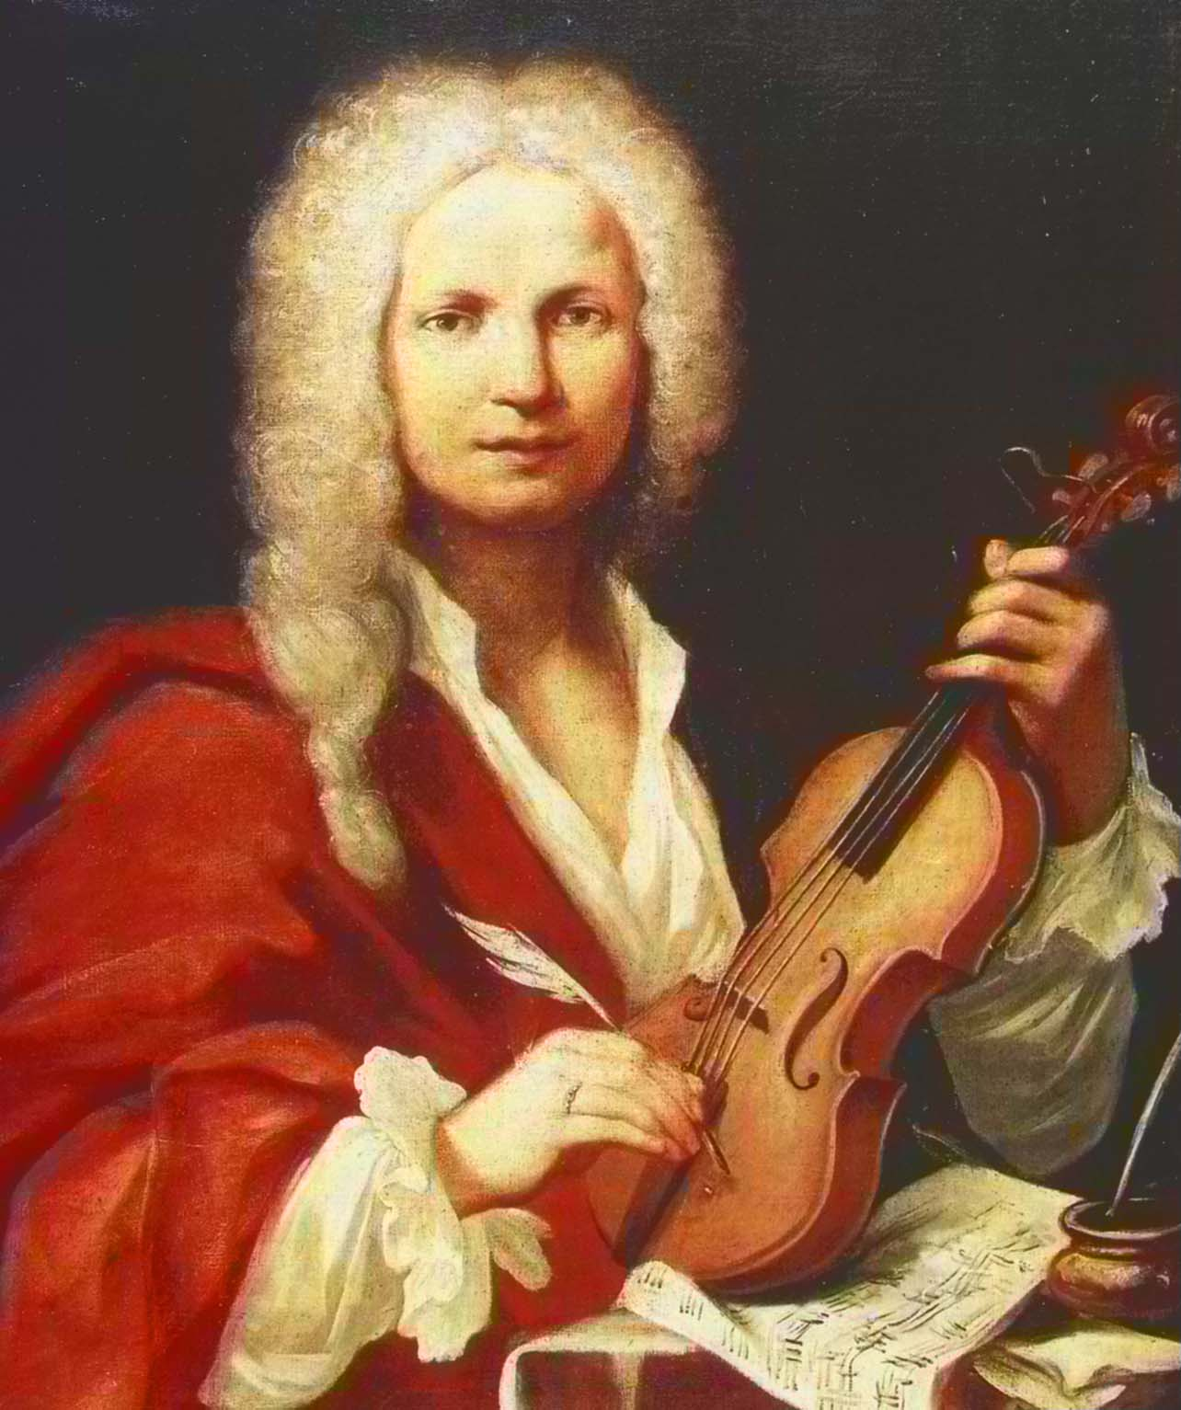
Antonio Vivaldi
Born in Venice
Famous and influential as a virtuoso violinist and composer
Composed 450 or so concerti grossi and solo concerto
He exploited the resources of the violin as well as other instruments

Slide 27
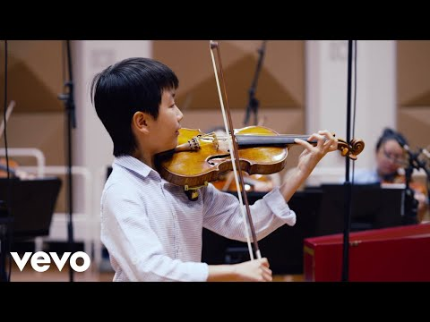
Four seasons: La Primavera

Slide 28
The Baroque Suite
Works that has dance-inspired movements
Movements are written in the same key but differ in tempo, meter and character
Consists of 5 movements with different origins:
Allemande – Moderately paced; from Germany
Courante – Fast; from France
Gavotte – Moderate; from France
Sarabande – Slow and Solemn; from Spain
Gigue – fast; from England and Ireland

Slide 29
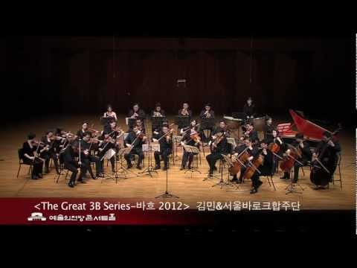
Bach Suite No.3 in D Major (1729 – 1731): 3. Gavotte

Slide 30
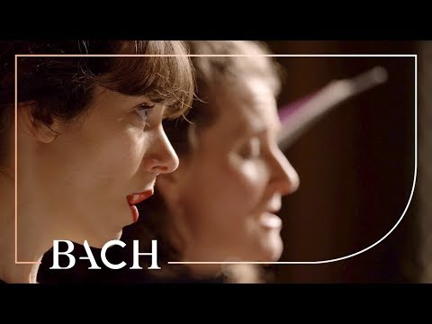
Chorale
The chorale, or hymn tune, was sung to a German religious text
Easy to sing and remember
One note to a syllable
Moves in steady rhythm

Slide 31
Church cantata
Cantata originally meant a piece that was sung, as distinct from a sonata, which was played.
Usually written for chorus, vocal soloists, organ, and a small orchestra
Had German religious text, either newly written or drawn from Bible or familiar hymns.
Lasts 25 minutes
Include several different movements – choruses, recitatives, arias and duets.

Slide 32
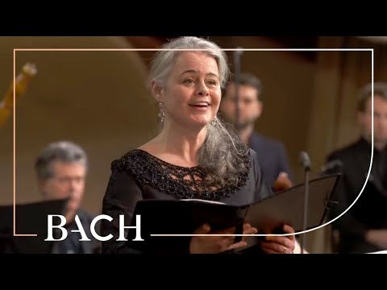
Bach Cantata Wachet auf, ruft uns die stimme BWV140 (Sleeper’s wake)

Slide 33
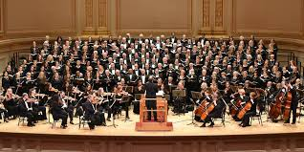
The Oratorio
A large scale composition for chorus, vocal soloists, and orchestra
Usually set to a narrative text
Different from opera, no acting, scenery or costumes

Slide 34
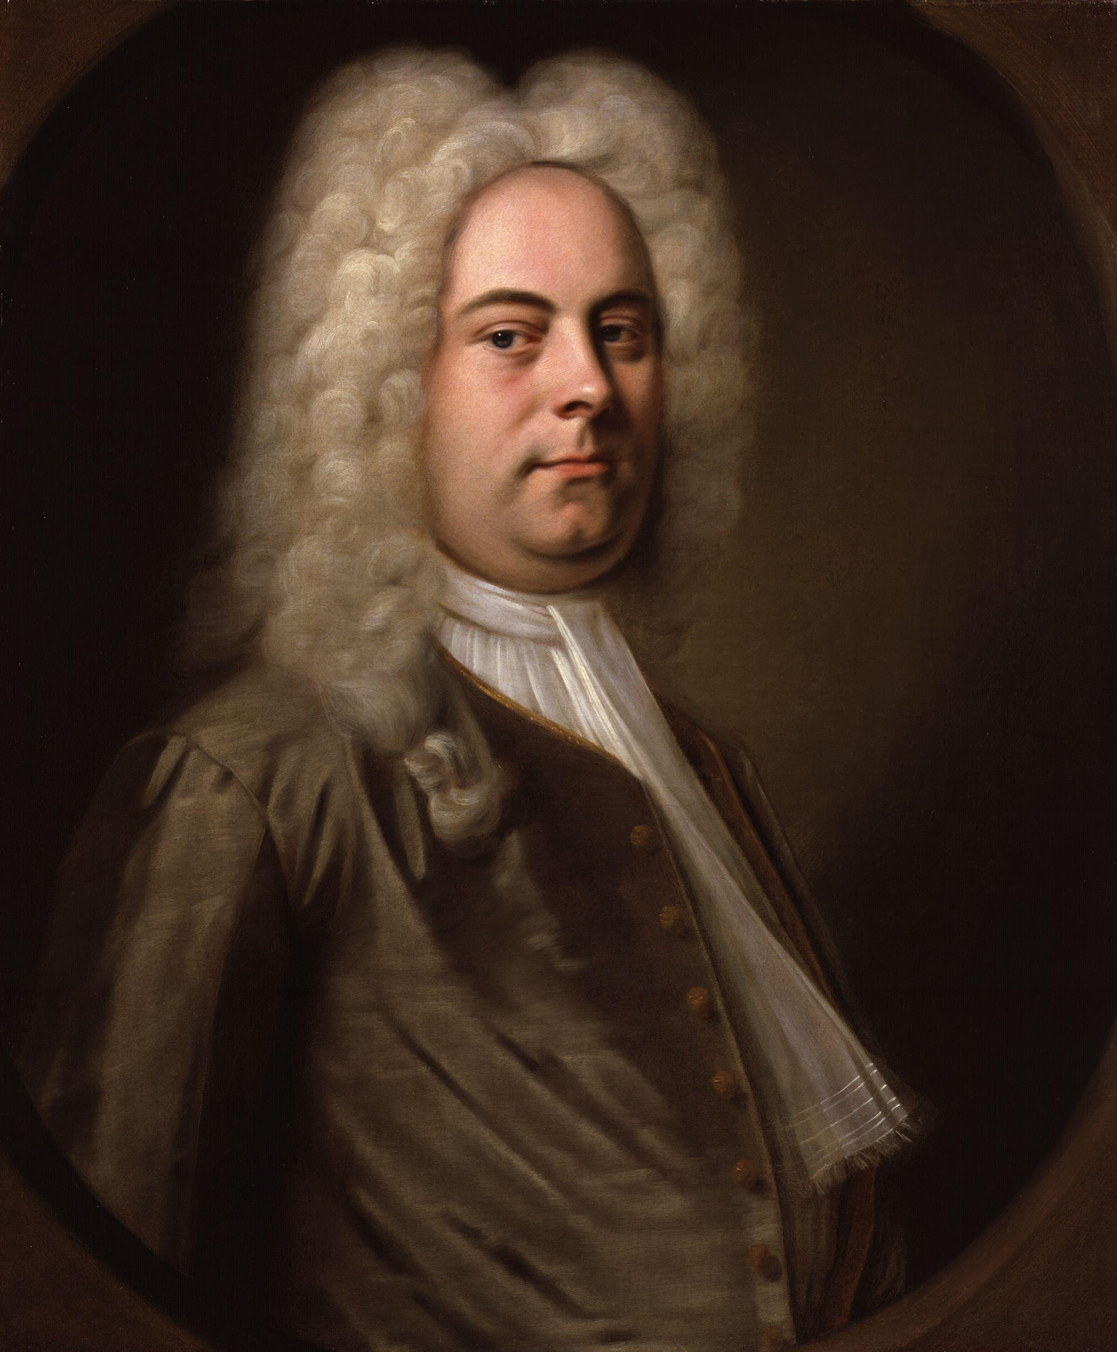
George Frederik Handel/Händel (1685 – 1759)
Born in Halle, Germany
Most of his English oratorios are based on stories from the Old Testament, but they are not church music.
Messiah is an exception
Never hesitated to reinforce an idea in his text by interrupting polyphonic flow of the music
Changes in textures are more frequent in his music in comparison to Bach’s music
Achieving changes of mood by shifting between minor keys and major keys

Slide 35
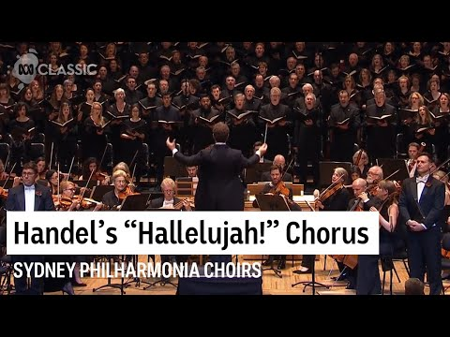
Messiah (1741)

